Slide 1

Sistemas Operativos de Tiempo Real
Proyecto: Sistema de Información Visual
para pasajeros de Trenes
Carlos Germán Carreño Romano
CESE 2020

Slide 2
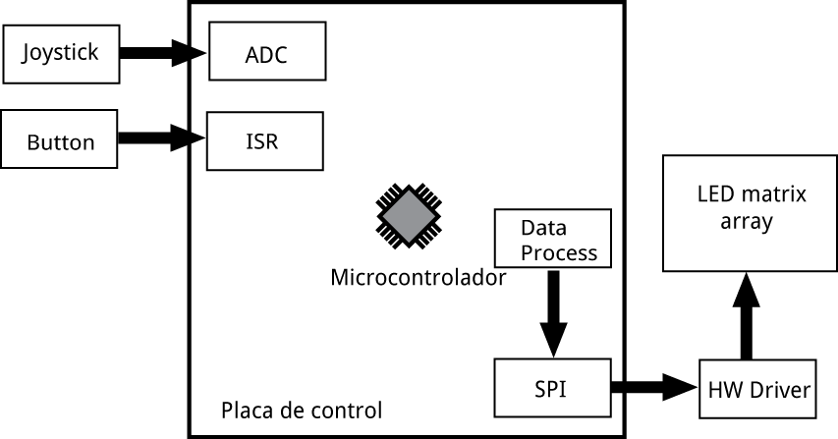
Diagrama de bloques

Slide 3
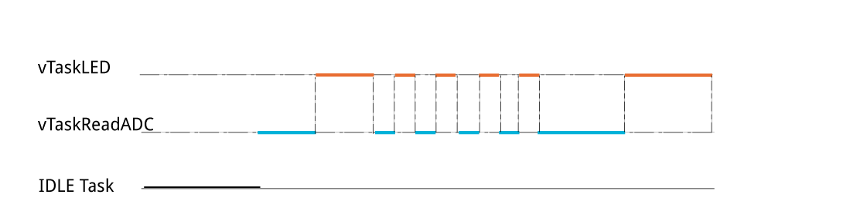
vTaskReadADC()
xTaskCreate(vTaskReadADC, (const char *)"Task readADC()", configMINIMAL_STACK_SIZE*4, &xTaskParamsADC[0], tskIDLE_PRIORITY+1,0 );
xTaskCreate(vTaskT1, (const char *)"Task Led", configMINIMAL_STACK_SIZE*2, &xTaskParams[0], tskIDLE_PRIORITY+1,0 );

Slide 4
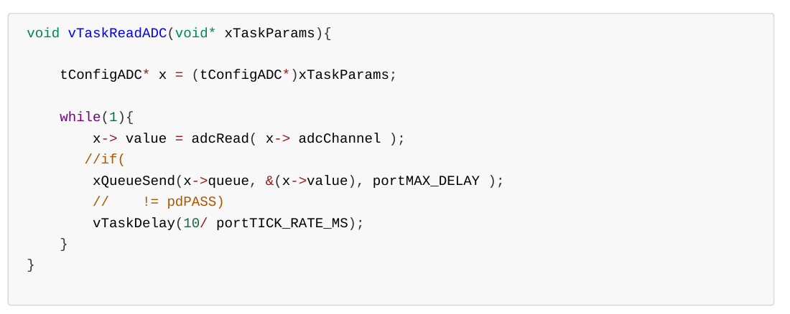
vTaskReadADC()

Slide 5
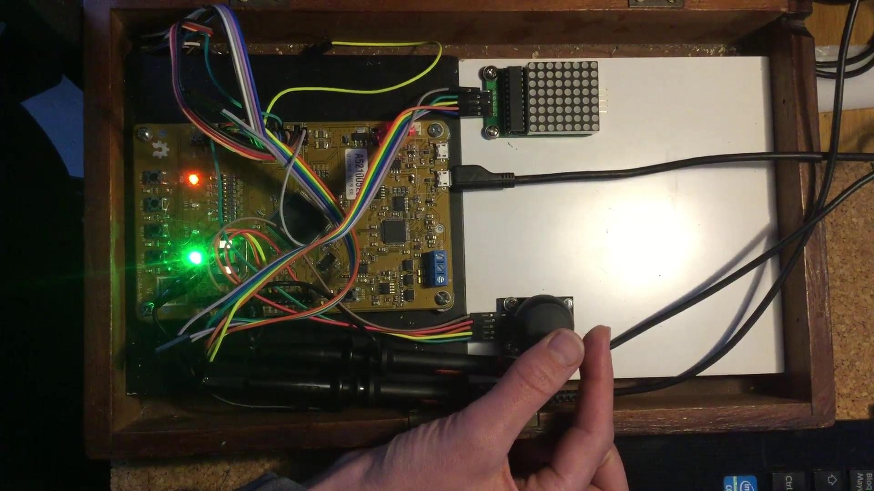
Demo
void vTaskLED (void* xTaskParams)
{
tConfig* x = (tConfig*)xTaskParams;
TickType_t t;
while(1){
xQueueReceive(x->queue,
&t, portMAX_DELAY);
gpioWrite(x->pinOut, ON);
vTaskDelay(t);
gpioWrite(x->pinOut, OFF);
}
}

Slide 6
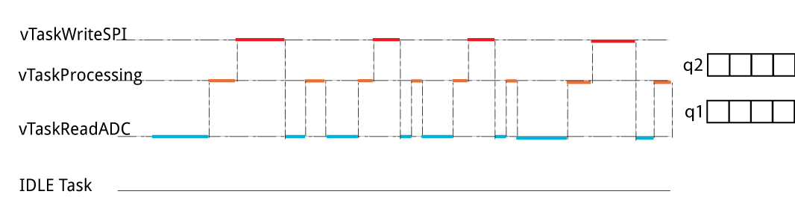
vTaskWriteSPI()
res=
xTaskCreate( vTaskWriteSPI, (const char *)"TaskWriteSPI()",
configMINIMAL_STACK_SIZE*4, &xTaskParamsADC[1], tskIDLE_PRIORITY+1,0 );
if(res==pdFAIL) ERROR_TASK_CREATE;

Slide 7
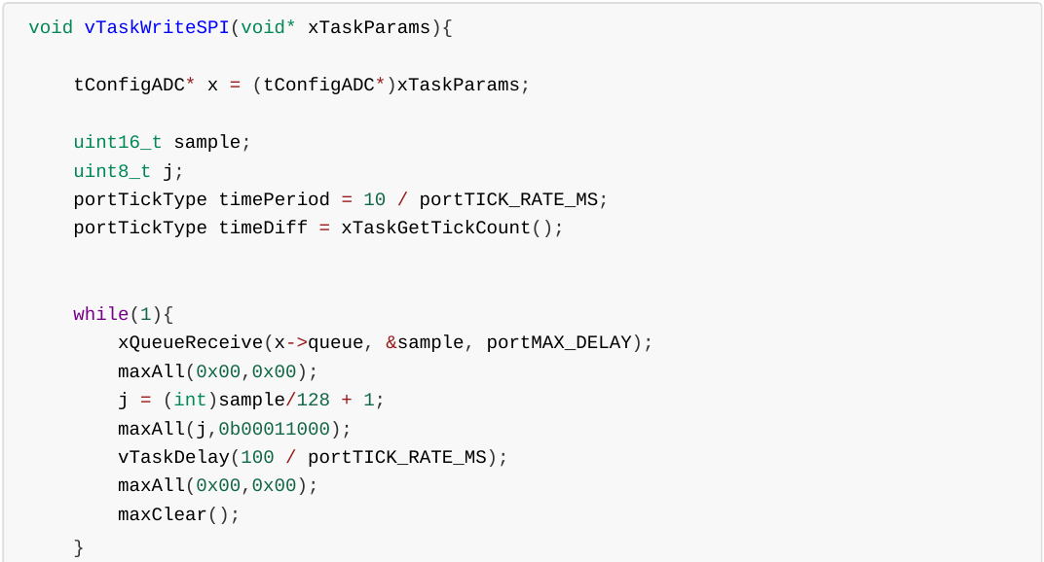
vTaskWriteSPI()

Slide 8
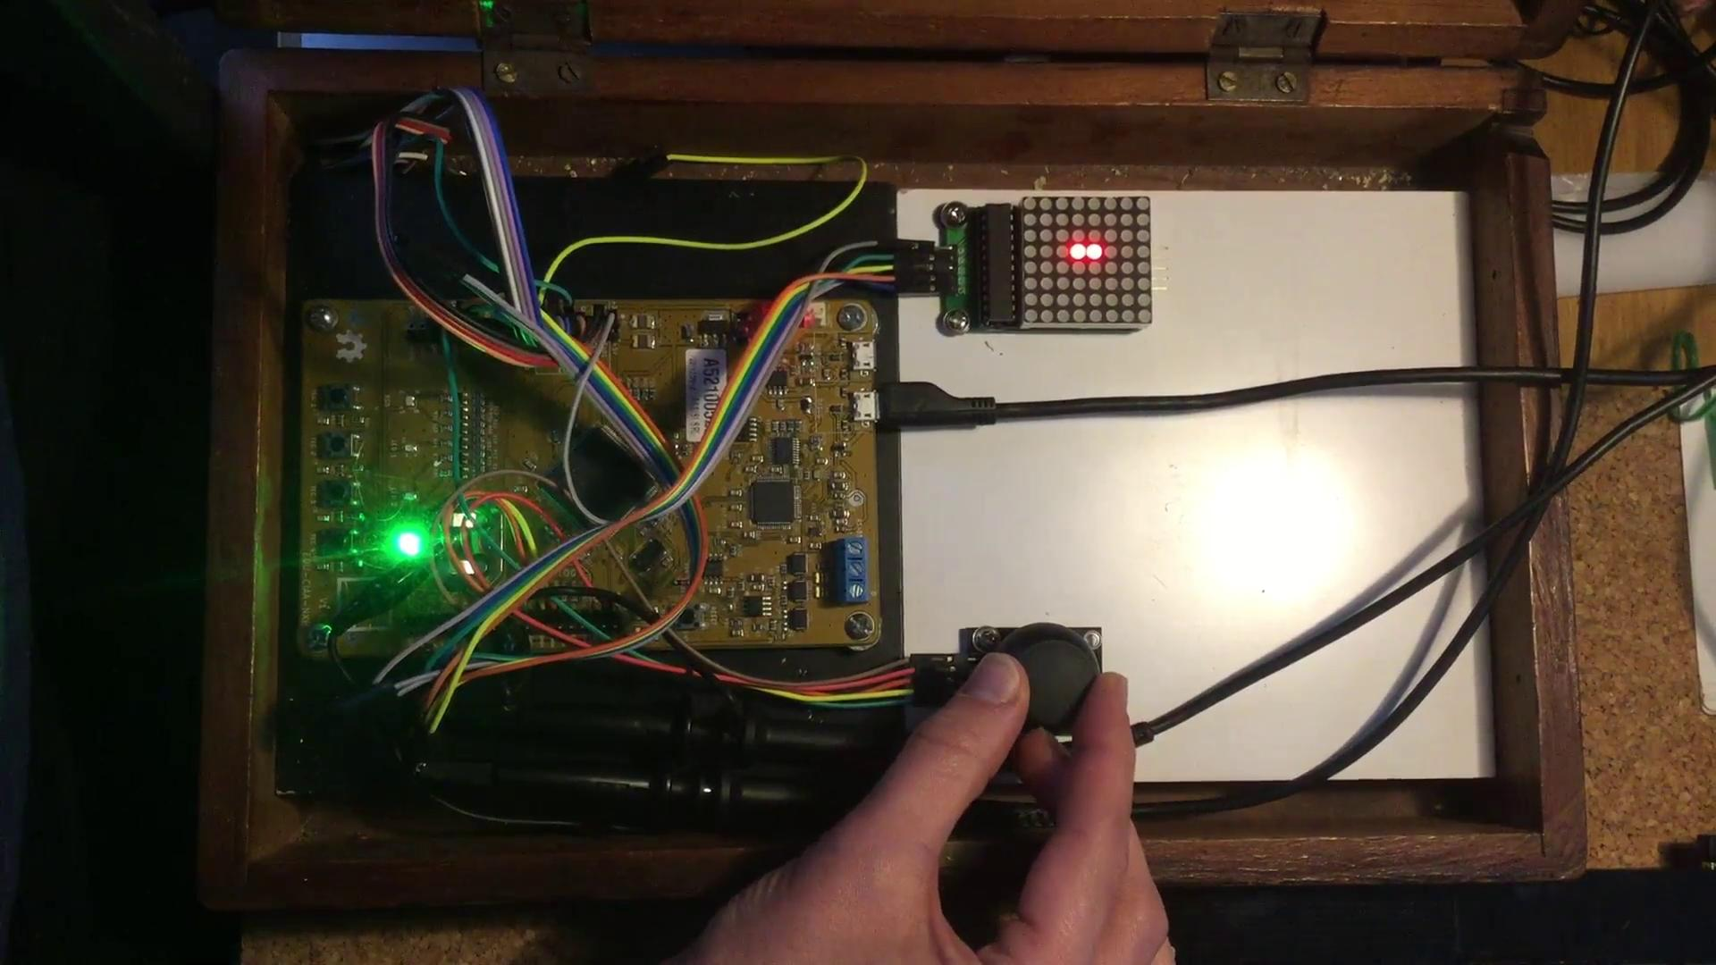
Demo
while(1){
…
sample_X = adcRead( CH1 );
sample_X = (int)sample_X/128;
...
j = sample_X + 1;
maxAll(0x00,0x00);
maxAll(j,0b00011000);
maxAll(0x00,0x00);
...
}

Slide 9
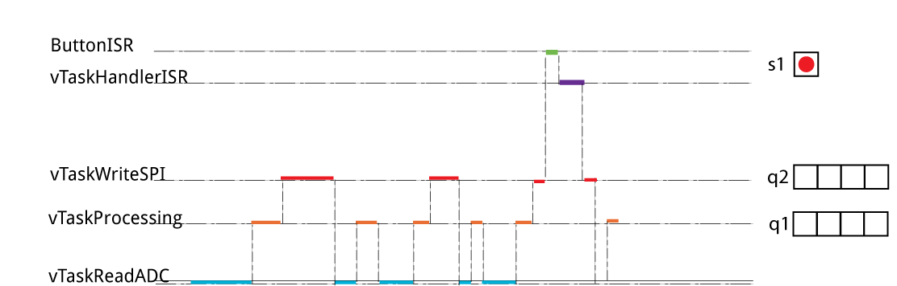
Interrupciones

Slide 10

freeRTOS_ProyectoRTOS1
inc
FreeRTOSConfig.h
ISR.h
tasks.h
types_config.h
MAX7219.h
src
main.c
Fsm_debounce.c
tasks.c
ISR.c
MAX7219.c

Slide 11
Conclusiones
Análisis de Prioridades
Uso de Colas
Uso de semáforos
Uso de interrupciones
Repo: https://github.com/charlieromano/CESE2020.git

